Slide 1
Low Cost Earthquake Detector
Bangladesh University of Engineering and Technology
Department of Electrical and Electronic Engineering
EEE 416 – Project Proposal Presentation
Presentation Date:19 December 2023
Presented by:
Tanvir Hossain Student ID: 1906040
Tasmin Khan Student ID: 1906055
Hasib Ur Rashid Ifti
Student ID: 1906059
4. Anindya Alam
Student ID: 1906065
Supervised by
Dr. Md Zunaid Baten
Associate Professor, BUET, EEE
2. Bejoy Sikder
Lecturer, BUET, EEE

Slide 2
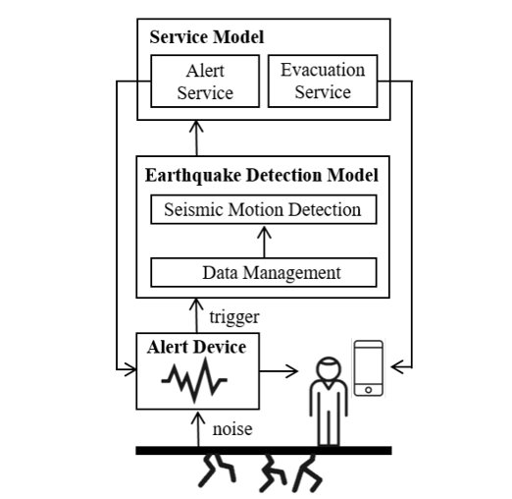
Overview
In our project, we plan to implement a system to detect earthquakes from mechanical vibration via a MEMS sensor, that will predict incoming earthquakes to alert people as well as to take some automated actions as necessary for safety

Slide 3
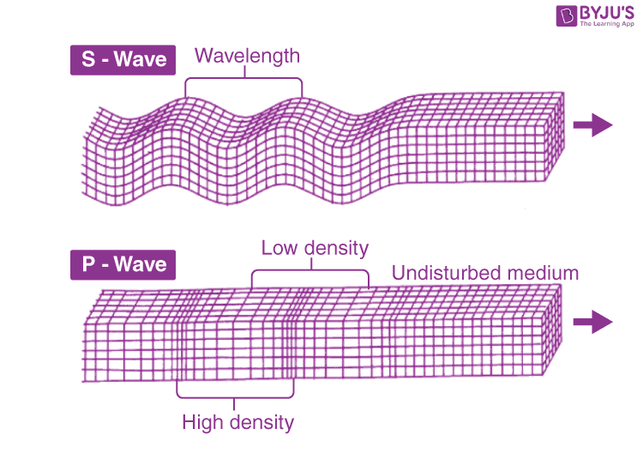
How to predict earthquakes?
During earthquakes, two events usually happen one after another. We first have a P wave in longitudinal direction which is much less damaging. There is a time gap of around 34 seconds between the two waves. Our plan is to utilize this short but crucial time to ensure safety.

Slide 4
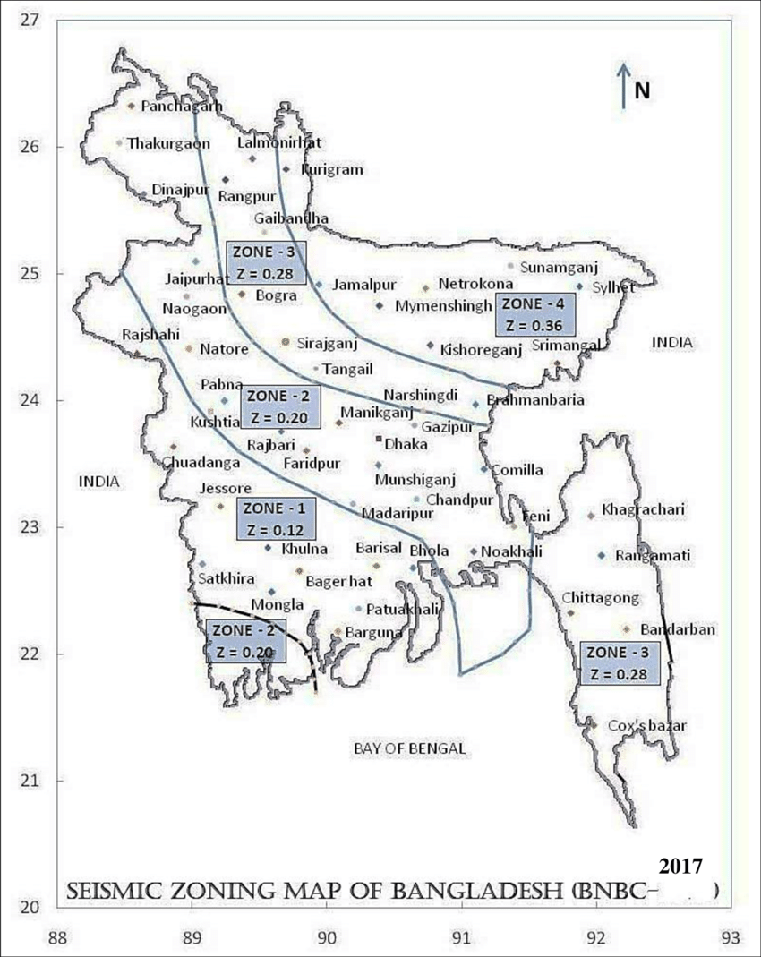
Where to set this up?
The locations of the different seismic zones are Rajshahi (Zone-1), Dhaka (Zone-2), Rangpur (Zone-3), and Sylhet (Zone-4). We can set our devices in peripheral locations to ensure we have to deal with as less noise as possible. For our project, we will implement one device which can easily be extended to multiple locations.

Slide 5
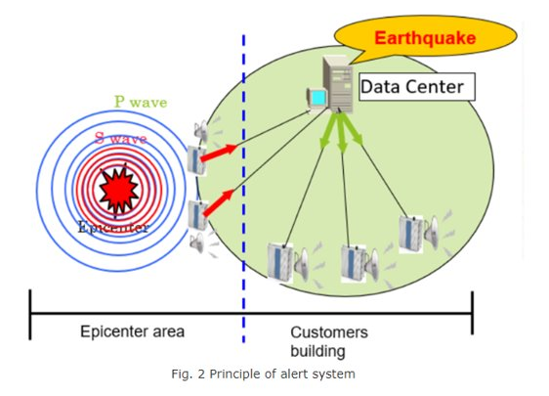
Application
The accelerometer (MEMS sensor) in our device will detect preliminary waves (P waves) in the event of an earthquake and an alarm is issued immediately, allowing people to evacuate before major shaking (S wave occurs). At the same time, it sends our control signals, stops elevators and machines and prevents damage.
We will use ADAfruit.io to create our cloud interface for real time access

Slide 6
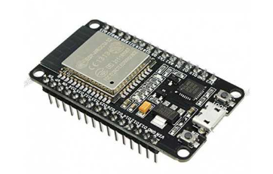
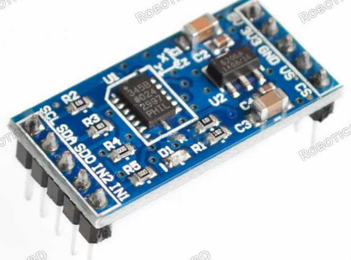
Design
Components to be used:
Microprocessor (esp32)
Accelerometer
Relays
DC voltage source
Cloud Interface
SIM900A Mini Module

Slide 7
Method
Method
Acceleration parameter in a time window
Immediate comparison using Peripheral microcontroller
Data Acquisition
In a peripheral accelerometer
Necessary modification of parameters for better prediction with more noise immunity
Data sent to the server on cloud
Cloud access of the post processed and raw data of earthquake events
Disconnecting power supply to loads using relays
Alert is sent to the designated users
Post processing for frequency component analysis and parameter update

Slide 8
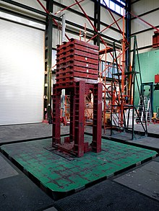
Implementation and Testing
We wish to use shake table in civil department for our testing purpose and fine tuning the parameters. This enables us to simulate the ground motions during an earthquake.

Slide 9
Proposed Novelty
Implementing cloud based alert system
Remotely disconnecting loads during earthquake
Using cloud-based post processing to update threshold for better predictions and noise immunity

Slide 10
Acknowledgement and References
Saleh Hamza Priyo (Research Assistant, Civil, BUET)
S. Kim, I. Khan, S. Choi and Y. -W. Kwon, "Earthquake Alert Device Using a Low-Cost Accelerometer and its Services," in IEEE Access, vol. 9, pp. 121964-121974, 2021, doi: 10.1109/ACCESS.2021.3103505.
J. Lee, J. -S. Kim, S. Choi and Y. -W. Kwon, "A Smart Device Using Low-Cost Sensors to Detect Earthquakes," 2019 IEEE International Conference on Big Data and Smart Computing (BigComp), Kyoto, Japan, 2019, pp. 1-4, doi: 10.1109/BIGCOMP.2019.8679190.
Ahmed, Mohiuddin & Gopal, Chandra & Roy, & Das, Shishir & Hasan, Mehidi. (2019). Seismic Behavior of RCC Buildings under Revised Seismic Zone Classification by BNBC. 9. 21-28.

